Slide 1
SOCIFY- Dual Mode Communication Platform for Mental Health Support and Secure Chat & Call Using MERN Stack and Socket.IO
PRESENTED BY(BATCH NO:4)
BALAJI S :510621205003
SURESH P :510621205052
GUIDANCE BY
Mrs.S.SARANYA, M.E.,

Slide 2
Abstract
This MERN stack project develops a dual-purpose communication platform designed to address the diverse needs of its users. The platform features two distinct interfaces
Peer-to-Peer Communication: Enables users to engage in anonymous and secure conversations with other users, fostering a sense of community and providing a safe space for open dialogue and support.“Random Call”, by Paired random users from online. It allowed users to connect anonymously with other users based on Random.
Listener Communication: Provides a dedicated channel for users to connect with licensed listener for confidential and professional counselling and listening sessions.

Slide 3
This project aims to provide a valuable resource for individuals seeking both social connection and professional mental health support within a single, integrated platform.
The application leverages MongoDB for data storage, Express.js for backend API development, React.js for frontend user interface, and Node.js with Socket.IO for real-time communication. The system ensures secure authentication using JWT, providing a seamless and interactive user experience

Slide 4
Existing work
“Teletherapy Platform with Video Calling Features” by Gupta and Jain (2023) explored the use of Socket.IO and WebRTC for therapist-patient video sessions. Their work focused heavily on secure video communication and scheduling mechanisms. However, the user base was limited to counsellor-client interaction without incorporating a broader peer-to-peer module or anonymous access.
“Omegle”, omegle was a popular platform that paired random users for online chat, offering text, video, or both. It allowed users to connect anonymously and could optionally match users based on shared interests.
“Secure Mental Health Chat Application using MERN Stack”, Sharma et al. (2022) implemented a basic peer support platform that allowed users to communicate anonymously using text chat. While the system provided real-time interaction and basic user management, it lacked dedicated interfaces for licensed professionals and did not include calling features or robust authentication mechanisms like JWT

Slide 5
Proposed work
“Listener Platform with Voice Calling Features” by provides a dedicated channel for user to connect with licensed listener for confidential and professional counselling and listening sessions
“Random Call”, by Paired random users from online. It allowed users to connect anonymously with other users based on Random.
“Secure Chat Application ”, peer support platform that allowed users to communicate anonymously using text chat. While the system provided real-time interaction with other user without revealing user identity. User can login with any fake mail id. So user don’t want to feel fear about data leakage.

Slide 6
Advantage
Dual Support System: Provides both peer-to-peer and professional listener communication in a single platform.
Strong User Privacy: Anonymous login with secure JWT authentication ensures user data protection.
Real-Time Interaction: Instant messaging and calling powered by Socket.IO enable seamless real-time communication.
User-Friendly Interface: Built using React.js for an interactive and responsive user experience.
Mental Health Focused: Creates a safe environment for users seeking emotional support or professional counseling.

Slide 7
Existing work VS Proposed work
Existing work
Proposed Work
Text (Secure Chat App, Omegle), Video (Teletherapy), Random Voice Matching (Omegle).
Basic anonymous login, but some needed email (Omegle optional login) Omegle provided random pairing, Secure Chat offered basic text chat without matching features
Weak or missing in platforms like Secure Chat App; Teletherapy had user login but limited peer features
Only Teletherapy Platform had it, but restricted only to scheduled video sessions, no broader support for random or anonymous peer interaction
Voice Calling with professionals (Listener Platform) + Random Voice Call with other users (Random Call) + Anonymous Text Chat (Secure Chat Application).
Stronger anonymity — allows login with fake email IDs to eliminate fear of identity leakage. Random Call feature with voice calling between anonymous users
Emphasis on user privacy without forcing real email verification; user-centric design for secure interaction
Dedicated channels for professional counseling via voice calls, separate from peer support module

Slide 8
Feature | Teletherapy Platform | Omegle | Secure Chat App | Proposed Work
Peer-to-peer communication | ❌ | ✅ | ✅ | ✅
Professional counselor access | ✅ | ❌ | ❌ | ✅
Anonymous login | ❌ | ✅ | ✅ | ✅
Voice calling | ❌ | ✅ (optional) | ❌ | ✅
Video calling | ✅ | ✅ | ❌ | ✅ (future scope)
Strong security (JWT, proper authentication) | ✅ | ❌ | ❌ | ✅

Slide 9
Requirement
Software Requirement
Hardware Requirement
MongoDB
Node.js
Express.js
React.js
Socket.IO
Any code editor (e.g., Visual Studio Code)
Postman for API testing
Processor: Intel i5 or equivalent.
RAM: 4 GB (minimum).
Storage: 128 GB SSD or higher.
Operating System: Windows/Linux/Mac.

Slide 10
Module Diagram
Home Page
Listener page
Call page
Chat page
Game page
Login Page
call with listener
Random call
Tortoise game
Admin page
Signup Page
Setting
Chat with any user
Login page

Slide 11
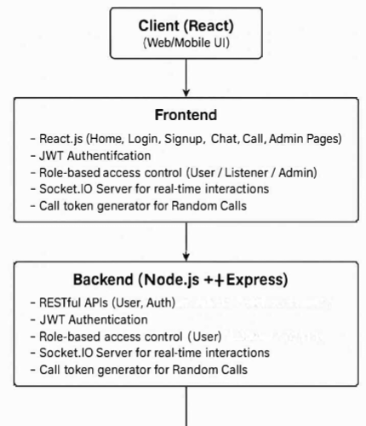
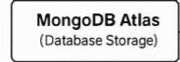
System Architecture

Slide 12
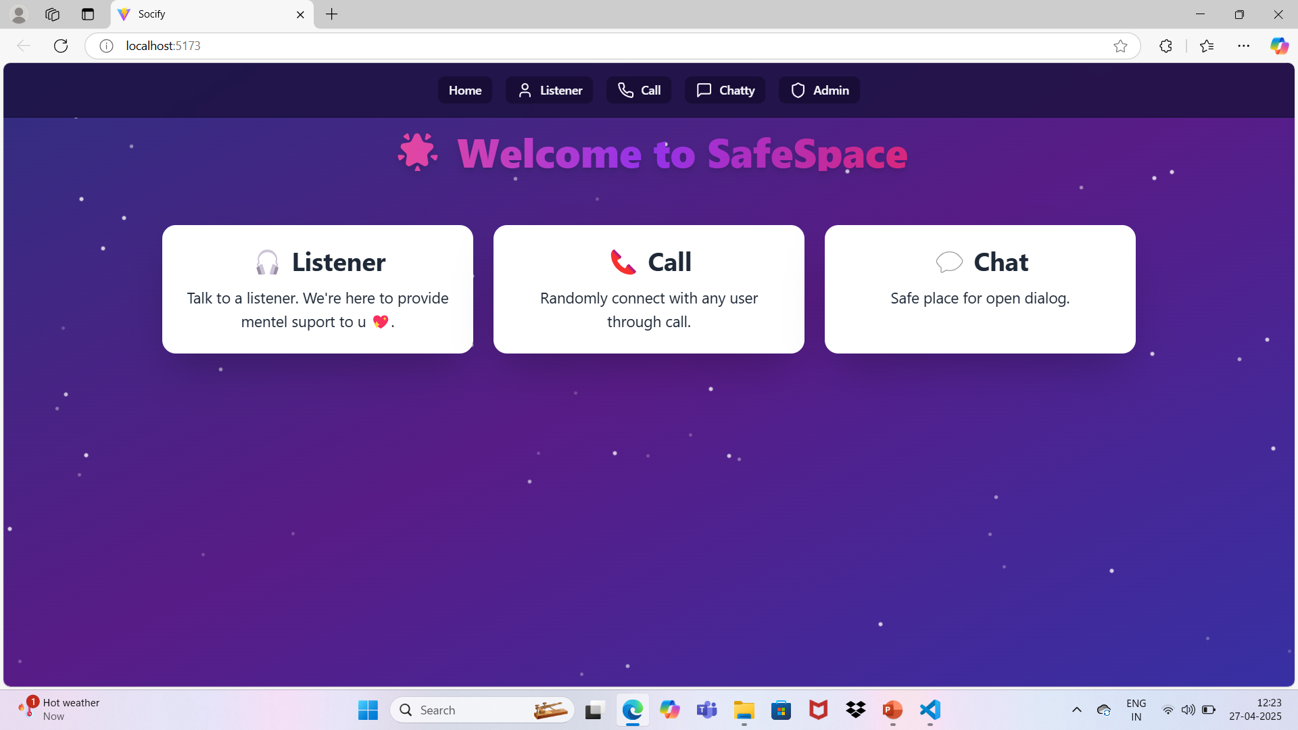
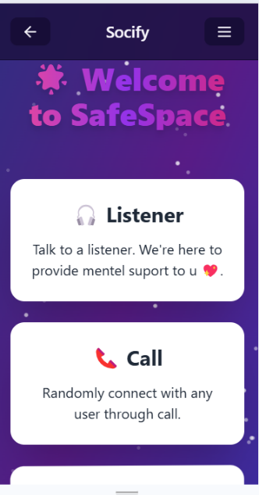
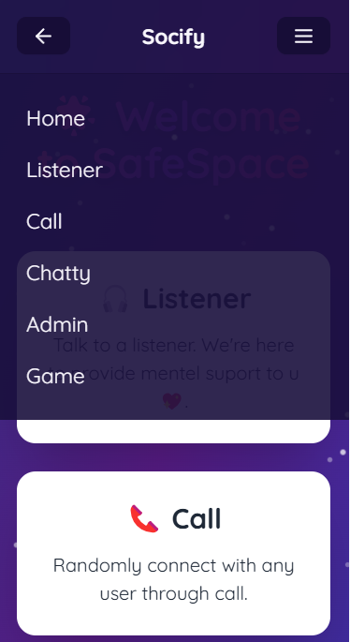
Home page
Home page is a navigation page for listener, call, chat and burger icon.

Slide 13
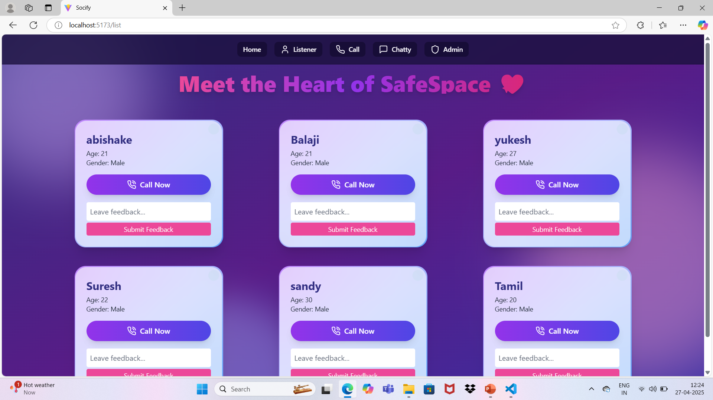
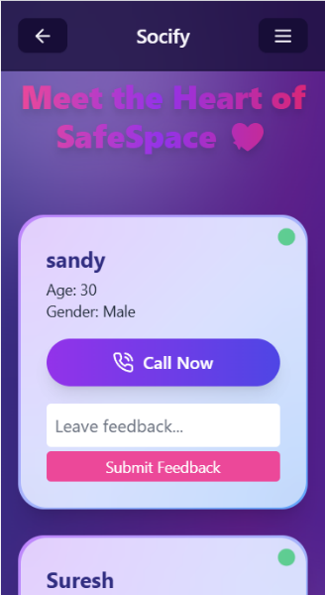
Listener page
In listener page user can talk with certified counsellor for the relief and listener will help for user mental health. User can give feedback for listener that feedback will show in admin page.

Slide 14
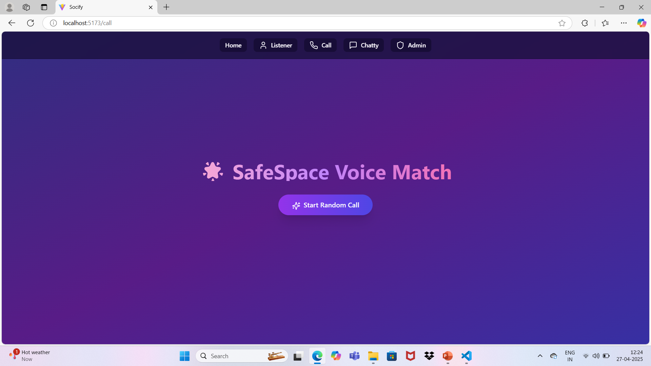
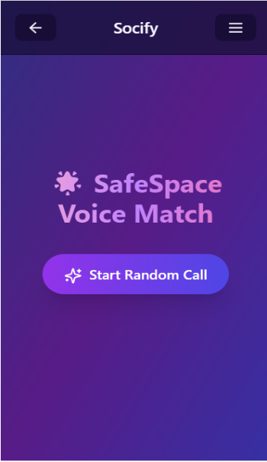
Call page
In call page any online user can randomly connect with any online user randomly. Backend Api provide temporary token to the user when they make call. This temporary token helps to make call. Random user can connect with another random user

Slide 15
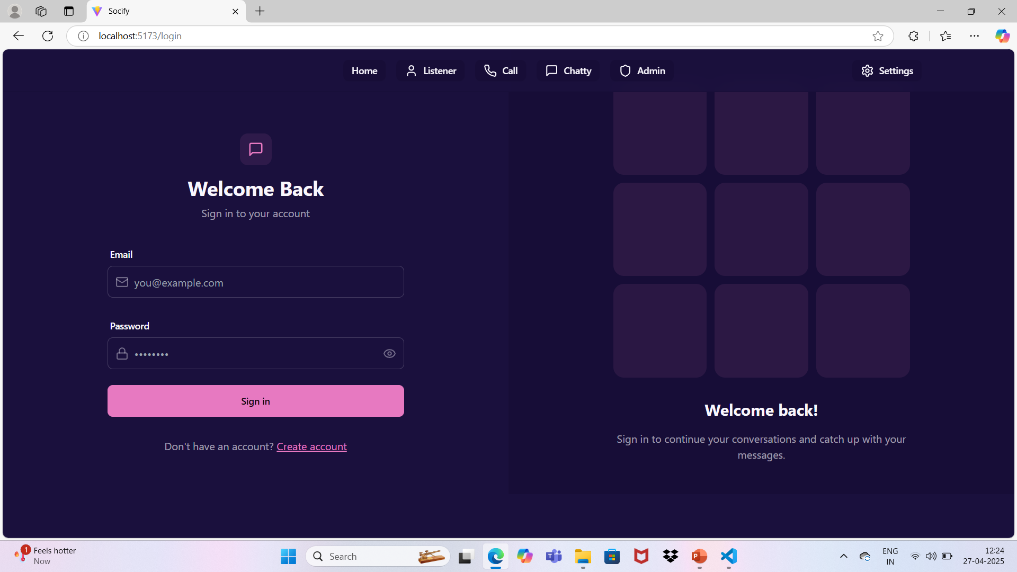
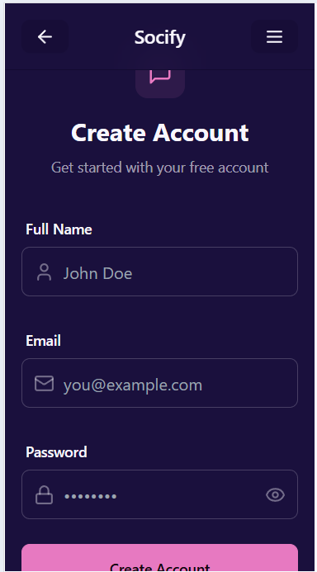
User login and sign up page
In signing and login page user can create account Using any random are face mail id.

Slide 16
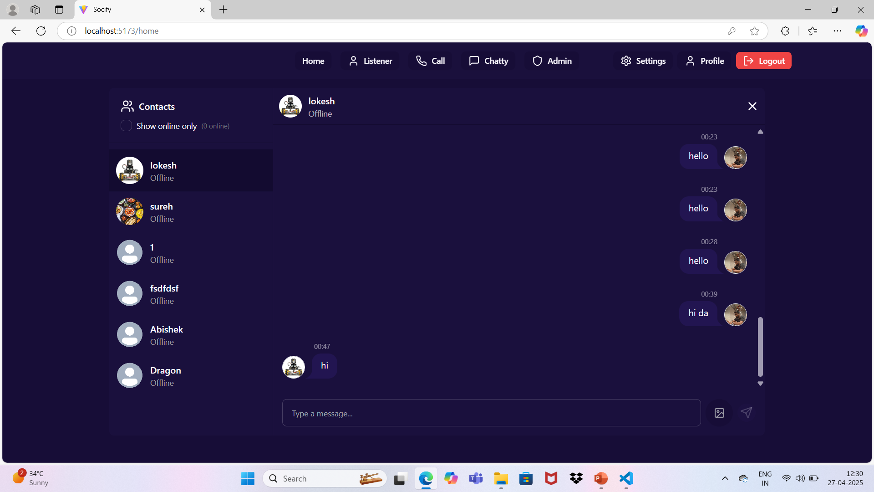
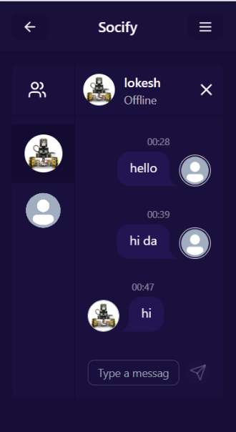
Chat page
In chatting page any user can message to other user. It is open place for open dialog

Slide 17
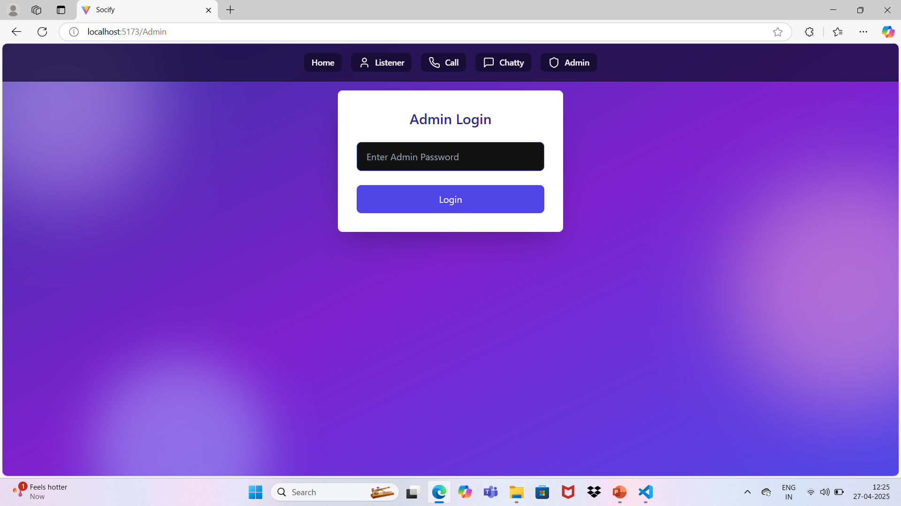
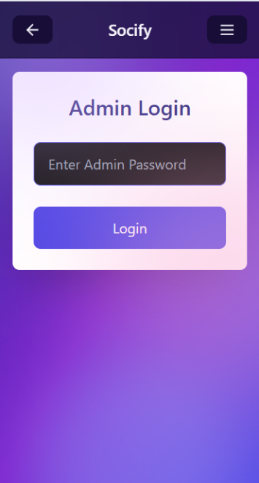
Admin login page
Admin can login using already created password in backend.

Slide 18
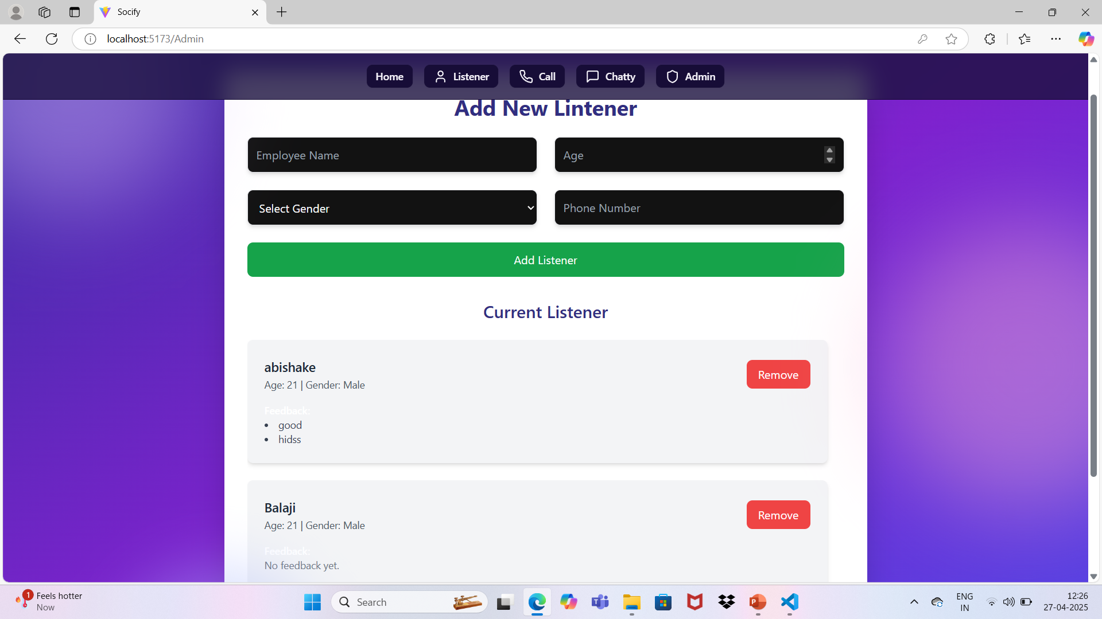
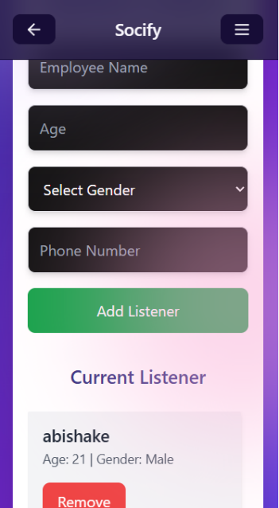
Admin page
Admin can able create new listener, admin can able see the feedback about listener what user gives feedback about listener. If any listener get bad and negative feedback then admin can remove that listener from the listener page.

Slide 19
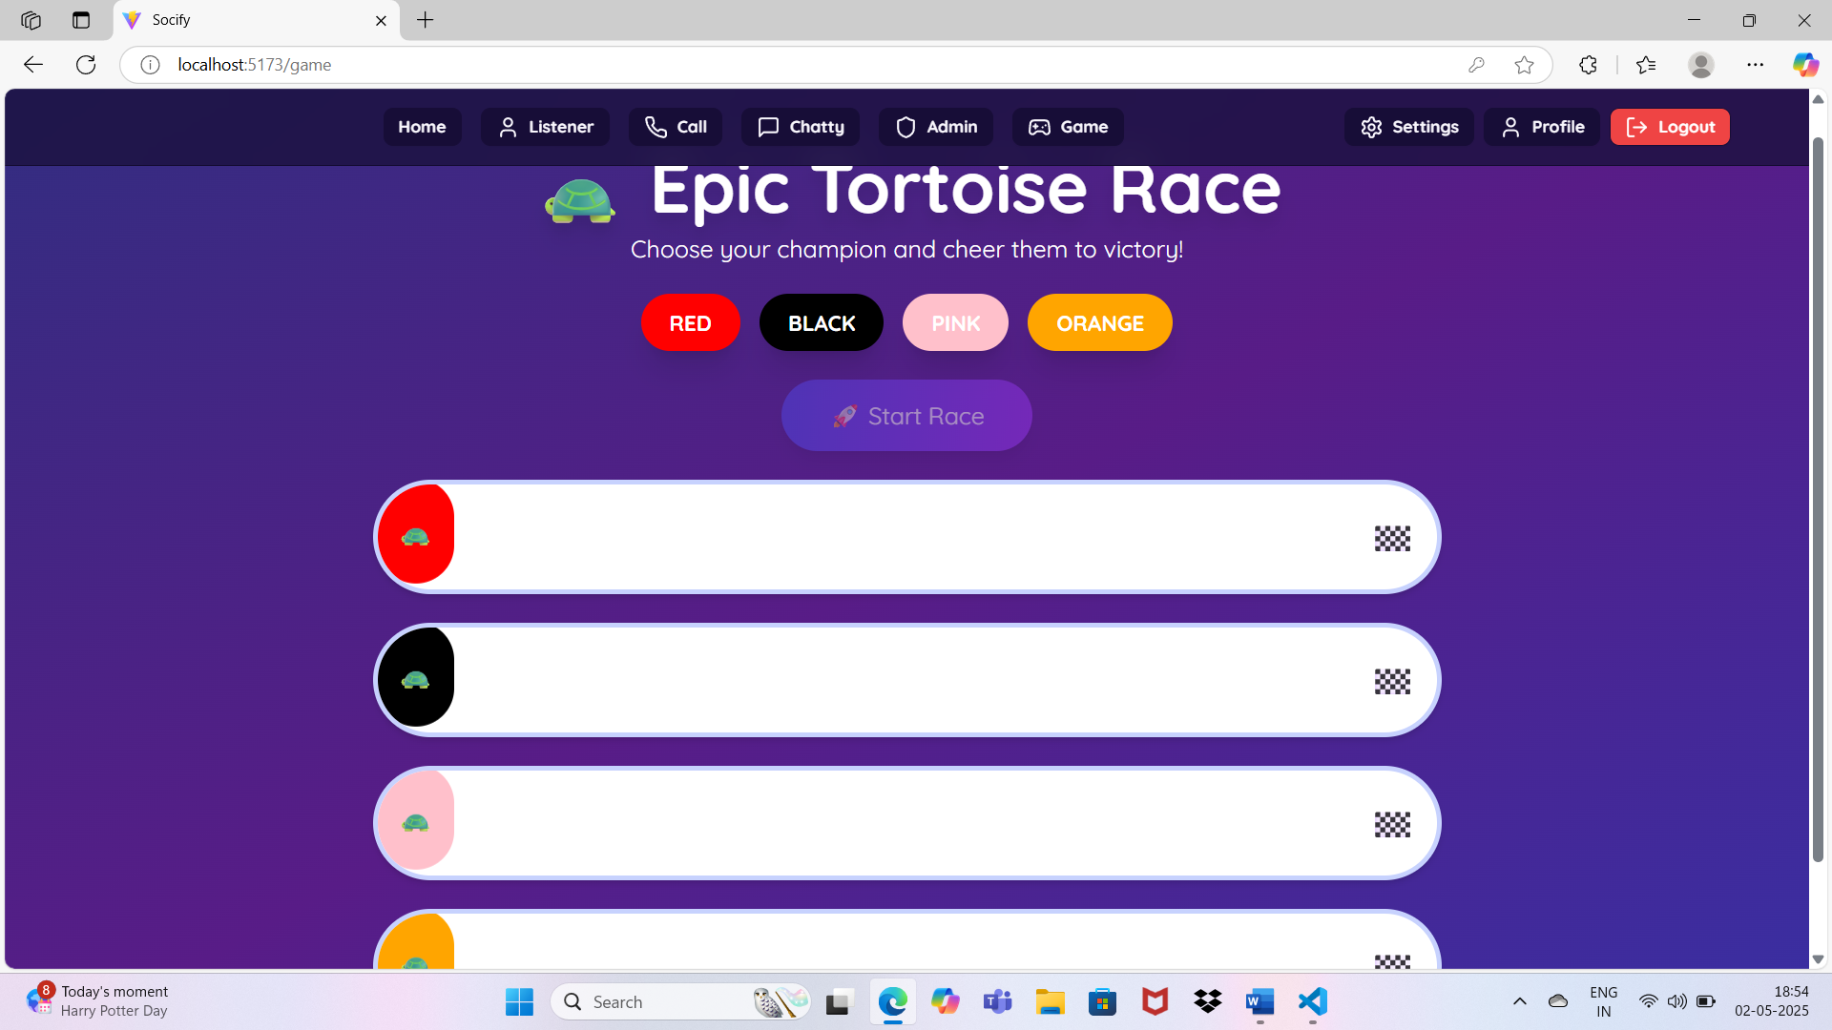
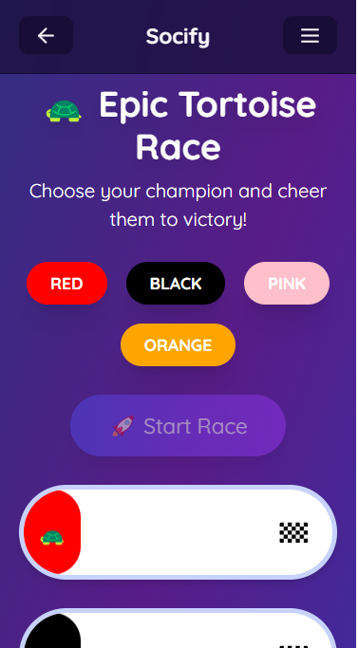
Game page
If user predicted tortoise is win then it show message as win other wise it shows better luck next time. This page is made for fun purpose.

Slide 20
Feature Enhancements
Video Calling Integration: Adding video support for more personal interaction with listeners and peers.
AI-Powered Matching: Smart matching users with suitable listeners or peers based on mood analysis or topics.
Emergency Support Button: A quick button for users in distress to get immediate professional help.

Slide 21
Conclusion
This MERN stack-based communication platform serves as a comprehensive solution for individuals seeking both social interaction and professional support. It not only enhances connectivity but also contributes to mental well-being by bridging the gap between users and professional counseling services.

Slide 22
References
[1] B. Kumar, A. Reddy, and P. Singh, “Secure Real-Time Chat Application Using MERN Stack and Socket.IO,” International Journal of Innovative Research in Computer and Communication Engineering (IJIRCCE), vol. 10, no. 7, 2022.
[2] R. Sharma and K. Verma, “Mental Health Support through Mobile Applications: A Case Study,” 2023 IEEE International Conference on Health Informatics and Medical Systems (HIMS), 2023.
[3] A. Mehta, S. Jain, and P. Shah, “Design and Development of a Teletherapy Platform Using WebRTC and Node.js,” 2022 International Conference on Smart Technologies in Computing, Electrical and Electronics (ICSTCEE), 2022.
[4] MongoDB Inc., “MongoDB – The Developer Data Platform,” [Online]. Available: https://www.mongodb.com
[5] Express.js, “Fast, unopinionated, minimalist web framework for Node.js,” [Online]. Available: https://expressjs.com
[6] React Documentation, “React – A JavaScript Library for Building User Interfaces,” [Online]. Available: https://reactjs.org
[7] Socket.IO Documentation, “Socket.IO – Bidirectional and low-latency communication for every platform,” [Online]. Available: https://socket.io
[8] Auth0, “Introduction to JSON Web Tokens,” [Online]. Available: https://auth0.com/learn/json-web-tokens

Slide 23


